Slide 1
AI Strategy and Governance
Risks with AI
Kartik Hosanagar, Professor of Operations, Information and Decisions

Slide 2

Risks with AI: Overfitting
Complex AI models such as neural nets can easily overfit (i.e. fit historical data too well but fail in realistic test conditions)
If we don’t understand what is helping the model perform well, there is a risk that the model will fail upon deployment
Operational Risks
Direct financial risks (e.g. a trading algorithm)
Customer perception and reputation (e.g. poor personalization experience)
ML Models need to go through thorough stress-testing (discussed later under audits)

Slide 3
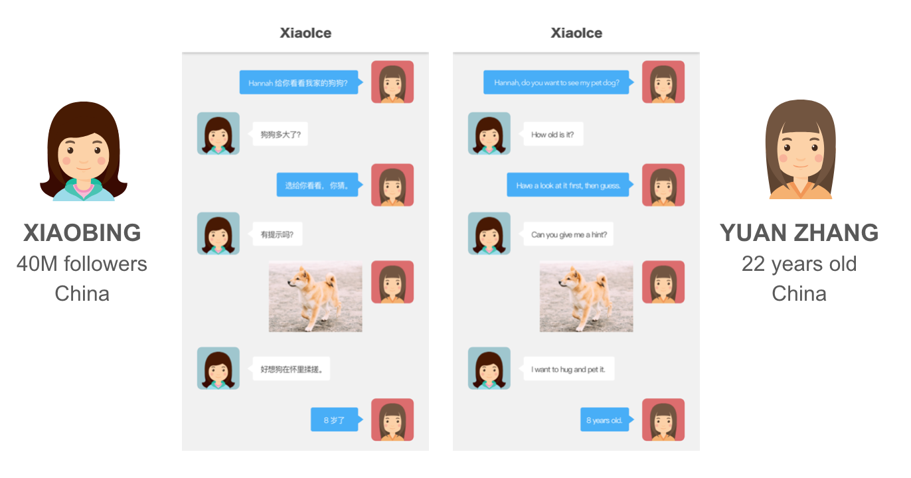
Xiaoice: Darling of Chinese Social Media

Slide 4

Xiaoice: Darling of Chinese Social Media

Slide 5


Tay.ai: Xiaoice’s Evil Cousin

Slide 6
Algorithm Bias in Recruiting Software
Amazon’s machine learning specialists uncovered a big problem: their new recruiting engine did not like women

Slide 7
Algorithms Incorrectly Predict Recidivism
There are higher false positive and false negative rates among African Americans
Algorithms racial bias in predicting recidivism rates

Slide 8
Why Might AI-Based Decisions be Unpredictable?
Algorithm Logic
Data
AI Behavior
Nature
Nurture
Analogous to human behavior, algorithms are driven by
nature and nurture.

Slide 9
Risks to Society
Social risks can result from automated decisions because these decisions may result in disadvantaged minorities continuing to be left behind
The AI Now Institute classifies theses risks into two groups:
Harms of Allocation
Harms of Representation
About situations when a scarce resource has to be allocated to people
E.g.: Unfair loan approval decisions, or job applicant decisions
About situations when a system represents a group in an unfavorable way
E.g.: Airport screening system being more likely to false alarm people of color (based on hairstyles)
Content/quotes from: https://medium.com/@jstanier/we-must-fix-ais-diversity-problem-6ad5fddc2f8c
Content from: https://gizmodo.com/microsoft-researcher-details-real-world-dangers-of-algo-1821129334

Slide 10
Risks to Firms
These social risks then create additional risks for companies
Reputational Risk
Legal Risk
Regulatory Risk
Perceived to be a biased, prejudiced company
Firms may face PR issues and backlash as a result
Sued for unfair practices and discrimination against particular groups
Increased regulation & cost of compliance
Upcoming interest in auditing and data protection (GDPR)

Slide 11
AI Strategy and Governance
Explainable AI: What is Explainable AI?
Prasanna (Sonny) Tambe, Associate Professor of Operations, Information and Decisions

Slide 12
AI Explainability
The use of methods in AI systems where why the algorithm arrived at a particular result can be easily understood by human experts
Closely related to interpretability — understanding why a decision was arrived at by an algorithm, even if you can’t necessarily explain that logic
Contrasts with the “black box” approach normally associated with some types of complex machine learning (e.g. deep learning)

Slide 13
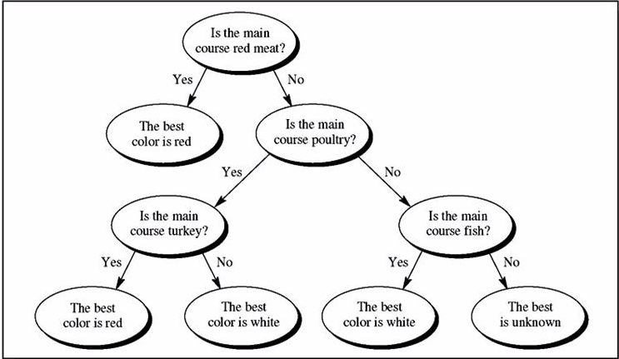
Decisions Based on Business Rules Are Easy to Explain

Slide 14
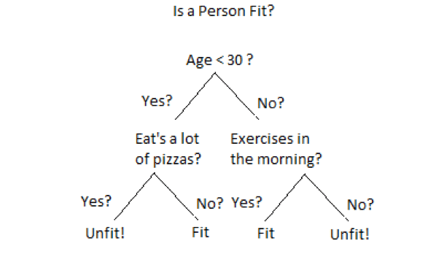
Decision Tree Models Are Relatively Easy to Interpret

Slide 15
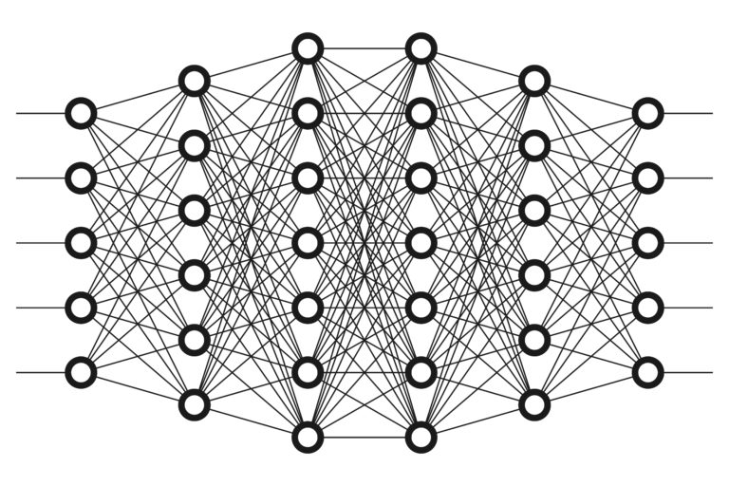
Deep Learning Models Are Difficult to Interpret

Slide 16
AI Explainability
Major tradeoff with more complex models
Able to handle enormous amounts of data and make very accurate predictions
Can be difficult to explain the logic
Explainability is the key to adoption in many contexts

Slide 17
AI Explainability
Big tech companies are currently heavily invested in this issue
Efforts by the government that are funding programs to develop better explainable AI

Slide 18
AI Strategy and Governance
Algorithmic Bias and Fairness
Kevin Werbach, Professor of Legal Studies and Business Ethics

Slide 19
Bias and Fairness
Data can embed human prejudice
If women traditionally fail to get promoted and enjoy long careers at a company because of rampant sexism, an AI system will find that being female is associated with poor outcomes
In other cases, the data itself can be biased
There may simply be fewer examples of minority populations in the training dataset, resulting in less-accurate models
Sometimes even when classifications such as race and gender aren’t even in the dataset, they influence models through proxies
A zipcode is just an address marker, but it can be strongly correlated with race or socio-economic status, for example

Slide 20
Technical Responses to Algorithmic Bias
There are now a variety of tools to incorporate fairness criteria into the design of algorithmic systems directly, or to assess whether they produce discriminatory results
However, they aren’t foolproof
There isn’t a single definition of fairness
Systems that are more fair might also be less accurate
In some cases, there may not be objective standards of fairness at all
It’s not an accident what data gets collected, how that data is evaluated, or what questions get asked in the design of algorithms
The same human factors that lead to marginalized groups being discriminated against in other contexts still apply here

Slide 21
Legal Responses of Algorithmic Bias
There are some legal claims that can be brought against biased or unfair algorithms, but their scope is quite limited
Disparate impact — when a policy or practice that appears to be neutral (doesn’t explicitly treat minority populations different from other populations) still has an effect of different treatment
Only applies to a limited set of protected classes, (e.g. race and gender)
Generally applies only to certain activities specified under the law (e.g. employment and housing)
Requires a defined “policy or practice” affecting a protected class
US Supreme Court has held that statistical disparity alone is not enough

Slide 22
Legal Responses of Algorithmic Bias
In Europe, the General Data Protection Regulariont (GDPR) has general anti-bias provision for ”fully-automated processing”
Limited context and not clear what counts as bias
Proposals for new laws
European Union AI paper
In the US, the Algorithmic Accountability Act

Slide 23
How Organizations Should Respond to These Challenges
Deep and diverse data
Think about proxies for illegitimate factors (e.g. zip codes)
Consider the appropriate fairness function
Test and evaluate system performance to assess tradeoffs
Be aware of hidden historical biases
Having diverse teams is critically important

Slide 24
AI Strategy and Governance
Manipulation
Kevin Werbach, Professor of Legal Studies and Business Ethics

Slide 25
Manipulation
Manipulation falls between legitimate persuasion and illegitimate coercion
Getting someone to do something that you want by somehow short-circuiting their capacity for rational decision-making
All manipulation isn’t illegal or unethical
Advertising, political campaigning, and fund-raising, for example
AI can manipulate people when it’s not obvious that choices or decisions are being shaped by algorithms

Slide 26
Manipulation: Facebook
Facebook collaborated with academic researchers to measure whether changes in its newsfeed algorithm could generate what psychologists call Emotional Contagion
It deliberately fed certain users happier content, and sure enough, they shared happier content with their friends
In other research Facebook found it could increase voter participation by tweaking the newsfeed
One of the challenges here is that everything you see on the Facebook newsfeed is the result of algorithms and they are changing all the time

Slide 27
Deception
Some forms of manipulation are legally prohibited, such as false or subliminal advertising, but those are generally defined narrowly
The major legal concept here is deception
It’s perfectly fine to market a product to customers that you think they want to buy, even when it’s personalized through AI, because users understand that advertising is about selling them things
The problem comes when the nature of the relationship isn’t obvious

Slide 28
Exploitation
Exploitation is a more harmful form of manipulation that involves taking advantage of vulnerabilities to produce voluntary agreements that would not occur in a competitive market
UK airlines deliberately seating families apart from one another when they purchased cheaper tickets, in order to encourage them to upgrade to higher priced tickets so they could sit together
Leaked Facebook advertising presentation suggested it could identify when teenagers were feeling “worthless,” “insecure,” or “anxious”
This is the point at which responsible AI practitioners need to draw a line
If you wouldn’t consciously design a business practice to exploit vulnerable people, you shouldn’t do it through algorithms

Slide 29
Market Manipulation
Using algorithms to subtly undermine competitive markets
Amazon sells both third party products and its own private-label offerings
Its search engine doesn’t directly prioritize its own products, but it does incorporate signals that use proxies for Amazon’s profitability, which could result in that kind of bias
In some cases, algorithms can execute collusive strategies
2018 DOJ action against poster sellers on Amazon
Researchers have shown that machine learning algorithms may self-discover collusive strategies

Slide 30
Manipulation Responses
There is no bright line defining manipulation, except perhaps in the market manipulation cases where general principles of antitrust or competition policy can be applied
The question you should ask yourself is whether the objectives of your AI system are creating mutually beneficial relationships with your stakeholders
Are people getting what they would likely choose on their own if they understood the nature of the relationship?
Or are you essentially tricking them?

Slide 31
Manipulation Responses
In the context of academic research on human subjects, a standard set of principles were developed in something called the Belmont Report in the 1970s
The four main elements are:
Informed consent — meaning users truly understand what they are getting into, unless it’s something that involved no real risk to them
Beneficence — “do not harm”
Justice — non-exploitative, administered fairly
A dedicated review board

Slide 32
Manipulation Responses
Many organizations find it helpful to have a dedicated center of excellence or committee to evaluate these and other ethical questions about major AI implementations
Shouldn’t come at the expense of diffusing responsible AI throughout the organization

Slide 33
AI Strategy and Governance
Data Protection
Kevin Werbach, Professor of Legal Studies and Business Ethics

Slide 34
Data Protection Introduction
Governments are increasingly concerned about what the scholar Shoshana Zuboff labeled “surveillance capitalism”
The business models that see personal data as a resource to be exploited through ever more sophisticated personalization and targeting
Ever since databases were widely applied in business in the 1960s, there have been concerns about how that power might be abused, or violate fundamental rights

Slide 35
Novel Data Protection Issues
Big data and machine learning raise novel data protection issues
Big data requires large datasets
Inferential privacy violations
e.g. Researcher Mikal Kosinski’s algorithm to predict sexual orientation based on Facebook profile photos or likes
Murky area, both legally and ethically
Models often require significant data transfers in order to be updated (e.g. from phones to the cloud)
Federated privacy can be used to moderate this problem

Slide 36
5 Stages of the Privacy Lifecycle
Collection
Aggregation/analysis
Storage
Use
Distribution

Slide 37
Data Protection: Legal Frameworks
US: Market based, user choice (notice and consent), sectoral
Europe: Human-rights based, comprehensive
GDRP applies to both data controllers and processors, for any personally identifying information involving European citizens
US
Europe
Opt-out
Opt-in
No requirement to specify purpose
Defined purpose/purpose limitation
Gray area regarding brokers
Regulates brokers
Additional rules for fully automated processing
Substantive rights

Slide 38
Data Protection: Legal Frameworks
Most other major jurisdictions adopting rules similar to the European approach
US is moving in that direction
Movement to require more explicit protections for AI systems when they involve high-risk data collection
Seem to be seeing a race to the top, rather than to the bottom
Especially for multinational companies

Slide 39
Data Protection: Responses
In building an AI project, it’s crucial to consider data protection at two levels: the technical level and the operational level

Slide 40
Data Protection at the Technical Level
There are a variety of techniques to make systems more privacy protective
Federated learning
Differential privacy
Mathematical technique for strategically adding noise to datasets
Statistical queries produce equivalent results, but it’s impossible to determine whether a particular individual is part of the dataset
Allows you to tune accuracy/privacy tradeoff precisely

Slide 41
Data Protection at the Operational Level
Privacy by design — first introduced by Ann Cavoukian, the privacy commissioner of Ontario, Canada, and now formally incorporated into GDPR
Incorporate privacy considerations into every decision involving personally-identifiable, or potentially personally-identifiable data, at every stage of the process
If everyone on your team is aware of the risks and thinking about where something could be problematic, you are much more likely to avoid a controversy
Formal mechanisms such as data impact assessments
The most important principle for privacy and data protection is to see them as pervasive considerations

Slide 42


